Slide 1


Slide 2
Father
Son
Bank Account
Bank Account
House
Inherit
Car
Inherit
Car
Motor Cycle

Slide 3
Another way to define a class
Inheritance..!!

Slide 4
Why Inheritance ?
  Inheritance is a mechanism for
    building class types from existing class types
    defining new class types to be a
      specialization
      augmentation
    of existing types

Slide 5
Inheritance Concept
class Rectangle{
private:
int width, length;
public:
void set(int w, int l);
int area();
}
Polygon
Rectangle
Triangle
class Polygon
{
private:
int width, length;
public:
void set(int w, int l);
}
class Triangle{
private:
int width, length;
public:
void set(int w, int l);
int area();
}

Slide 6
Inheritance Concept
class Polygon
{
protected:
int width, length;
public:
void set(int w, int l);
}
Polygon
Rectangle
Triangle
class Rectangle{
protected:
int width, length;
public:
void set(int w, int l);
int area();
}
class Rectangle : public Polygon
{
public: int area();
}
Notes:
Derivation is often represented graphically by a pointer from the derived class to its base class indicating that the derived class refers to its base
A derived class is often said to inherit properties from its base, s the relationship is also called inheritance
Base class: superclass; derived class: subclass
Derived class is larger than the base class.

Slide 7
Inheritance Concept
class Polygon
{
protected:
int width, length;
public:
void set(int w, int l);
}
Polygon
Rectangle
Triangle
class Triangle{
protected:
int width, length;
public:
void set(int w, int l);
int area();
}
class Triangle : public Polygon
{
public: int area();
}

Slide 8
Inheritance Concept
class Point
{
protected:
int x, y;
public:
void set(int a, int b);
}
Point
x
y
Circle
3D-Point
x
y
r
x
y
z
class Circle : public Point
{
private:
double r;
}
class 3D-Point: public Point
{
private:
int z;
}

Slide 9
Inheritance Concept
Augmenting the original class
Specializing the original class
Polygon
Point
Rectangle
Triangle
Circle
3D-Point
ComplexNumber
real
imag
RealNumber
ImaginaryNumber
imag
real

Slide 10
Define a Class Hierarchy
Syntax:
class DerivedClassName : access-level BaseClassName
where
  access-level specifies the type of derivation
    private by default, or
    public
Any class can serve as a base class
  Thus a derived class can also be a base class

Slide 11
Class Derivation
Point
class Point{
protected:
int x, y;
public:
void set(int a, int b);
}
3D-Point
Sphere
class 3D-Point : public Point{
private: double z;
… …
}
class Sphere : public 3D-Point{
private: double r;
… …
}
Point is the base class of 3D-Point, while 3D-Point is the base class of Sphere

Slide 12
What to inherit?
In principle, every member of a base class is inherited by a derived class
  just with different access permission

Slide 13
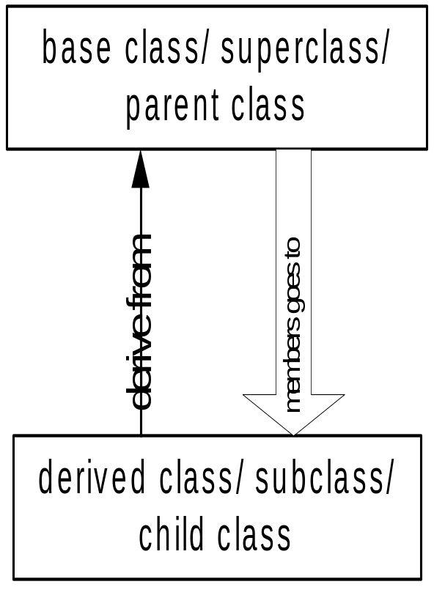
Access Control Over the Members
Two levels of access control over class members
  class definition
  inheritance type
class Point{
protected: int x, y;
public: void set(int a, int b);
}
class Circle : public Point{
… …
}

Slide 14

Private Inheritance
public and protected members of the base class become private members of the derived class.

Slide 15
Public Inheritance
public and protected members of the base class become respectively public and protected members of the derived class.

Slide 16
Protected Inheritance
public and protected members of the base class become protected members of the derived class.

Slide 17
Access Rights of Derived Classes
Type of Inheritance
 | private | protected | public
private | private | private | private
protected | private | protected | protected
public | private | protected | public
Access Control
for Members
The type of inheritance defines the minimum access level for the members of derived class that are inherited from the base class
With public inheritance, the derived class follow the same access permission as in the base class
With protected inheritance, the public and the protected members inherited from the base class can be accessed in the derived class as protected members
With private inheritance, none of the members of base class is accessible by the derived class
Notes:
In a public base class, public and protected members of the base class remain public and protected members of the derived class.
In a protected base class, public and protected members of the base class are protected members of the derived class.
In a private base class, public and protected members of the base class become private members of the derived class.
In all cases, private members of the base class remain private.
Private members of the base class cannot be used by the derived class unless friend declarations within the base class explicitly grant access to them.

Slide 18
Types of Class Members
Accessible to derived
classes and the instances
Public
Protected
Private
Accessible
to derived
classes only
?
not
accessible
Derived Class

Slide 19
Class Derivation
class daughter : public mother{
private:
double a;
public:
void foo ( );
}
mother
daughter
son
class mother{
protected:
int x, y;
public:
void set(int a, int b);
private:
int z;
}
void daughter :: foo ( ){
x = y = 20;
set(5, 10);
cout<<“value of a ”<<a<<endl;
z = 100; // error, a private member
}
daughter can access 3 of the 4 inherited members

Slide 20
Class Derivation
class son : protected mother{
private:
double b;
public:
void foo ( );
}
mother
daughter
son
class mother{
protected:
int x, y;
public:
void set(int a, int b);
private:
int z;
}
void son :: foo ( ){
x = y = 20;
set(5, 10); //it becomes a protect member
cout<<“value of b ”<<b<<endl;
z = 100; // error, not a public member
}
son can access only 1 of the 4 inherited member

Slide 21
What to inherit?
In principle, every member of a base class is inherited by a derived class
  just with different access permission
However, there are exceptions for
  constructor and destructor
  operator=() member
  friends
Since all these functions are class-specific

Slide 22
Constructor Rules for Derived Classes
The default constructor and the destructor of the base class are always called when a new object of a derived class is created or destroyed.
class A {
public:
A ( )
{cout<< “A:default”<<endl;}
A (int a)
{cout<<“A:parameter”<<endl;}
}
class B : public A
{
public:
B (int a)
{cout<<“B”<<endl;}
}
output:
A:default
B
B test(1);

Slide 23
Constructor Rules for Derived Classes
You can also specify an constructor of the base class other than the default constructor
  DerivedClassCon ( derivedClass args ) : BaseClassCon ( baseClass args )
  { DerivedClass constructor body }
class A {
public:
A ( )
{cout<< “A:default”<<endl;}
A (int a)
{cout<<“A:parameter”<<endl;}
}
class C : public A
{
public:
C (int a) : A(a)
{cout<<“C”<<endl;}
}
output:
A:parameter
C
C test(1);
Notes:
A derived class constructor can specify initializes for its own members and immediate bases only; it cannot directly initialize members of a base

Slide 24
Define its Own Members
The derived class can also define its own members, in addition to the members inherited from the base class
class Point{
protected:
int x, y;
public:
void set(int a, int b);
}
Point
x
y
x
y
r
Circle
protected:
int x, y;
private:
double r;
public:
void set(int a, int b);
void set_r(double c);
class Circle : public Point{
private:
double r;
public:
void set_r(double c);
}

Slide 25
Even more …
A derived class can override methods defined in its parent class. With overriding,
  the method in the subclass has the identical signature to the method in the base class.
  a subclass implements its own version of a base class method.
class A {
protected:
int x, y;
public:
void print ()
{cout<<“From A”<<endl;}
}
class B : public A
{
public:
void print ()
{cout<<“From B”<<endl;}
}
Notes:
Base class: superclass,
Derived class: subclass

Slide 26
Access a Method
class Point
{
protected:
int x, y;
public:
void set(int a, int b)
{x=a; y=b;}
void foo ();
void print();
}
class Circle : public Point{
private: double r;
public:
void set (int a, int b, double c) {
Point :: set(a, b); //same name function call
r = c;
}
void print(); }
Circle C;
C.set(10,10,100); // from class Circle
C.foo (); // from base class Point
C.print(); // from class Circle
Point A;
A.set(30,50); // from base class Point
A.print(); // from base class Point

Slide 27
Take Home Message
Inheritance is a mechanism for defining new class types to be a specialization or an augmentation of existing types.
In principle, every member of a base class is inherited by a derived class with different access permissions, except for the constructors

